Slide 1
A fuzzy expert system for setting Brazilian highway speed limits
Najmieh Sadat Safarabadi
Fall 2022

Slide 2
AGENDA
Introduction​
​Areas of research
​Summary​

Slide 3
The whys
Speed limit should provide a balance between safety and traffic flow
For example, in Brazil the standard guidelines list a series of factors that influence speed limits but they do not provide a clear methodology to choose a speed limit for a highway segment. Therefore, under current Brazilian practice the decision-maker is faced with a subject decision that mostly relies on expert judgment.
The current paper proposes a fuzzy expert system for setting Brazilian highway speed limits.

Slide 4
Membership functions and fuzzy rules were extracted from expert’s evaluations of simulated highway scenarios.
The experts evaluated the scenarios using linguistic variable and proposed speed limits.
Then a mamdani fuzzy controller was developed.
The results shows that the fuzzy system is able to provide outputs that agree with the experts’ evaluations and with the existing speed limit.
Speed limits must provide a proper balance between safety and traffic flow.
Previous research has shown that reducing speed limits lead to reductions in both crash frequency and crash severity.
While relaxing speed limits provides adverse impacts on road safety. However, excessively lowering speed limits might cause reductions in travel time or an increase in delay.

Slide 5
In fact a study in Brazil found that the V85 is not among the most important variables that influences the settlement of highway speed limit in the country, although this variable is recommended by the Brazilian guidelines.

Slide 6
We have a formula called V85 for this:

Slide 7
In this formula V85 is the operational speed
R is the curve radius
S is the curve side ( 0 = right, 1=left)
G is the dummy variables for upgrade (0= downgrade, 1 = upgrade)
Terrain: this means the average absolute terrain slope. The slope was computed for every consecutive. Because in Brazil stations are spaced every 20 meters the average terrain slope was calculated considering the slopes of the various 20-meter segments.
Intensity of Occupation: minimum number of parking spaces required which is used as a proxy for the number of people who would normally occupy the highway surroundings.

Slide 8
Previous research has shown that continuous speed data can be used for setting speed limits. However, for agencies with limited access to field measurements the v85 can be calculated using speed prediction models which are based on the geometric design.
Other variables such as roadside occupation, crash data etc should also be considered for setting speed limits. However, these factors are not clearly related and their consideration in speed limit selection process might be highly subjective.

Slide 9
But classifying a rural or urban environment or a mixed environment is left at the discretion of the expert responsible for posting the speed limit. Thus, this process is associated with inaccurate definitions that may considerably change the final speed limit.
Techniques that account for the uncertainty in linguistic variables such as rural, mixed or urban land use can be used to overcome the ambiguity in the process of selecting a speed limit.

Slide 10
For example, the fuzzy logic can deal with these shortcomings as it considers membership functions to measure the belonging to a category
Therefore, the fuzzy logic can be used to design expert systems and incorporate various degrees of uncertainty.
A fuzzy expert system considers a set of inputs, a set of rules, and an output.
Both the inputs and the output are expressed in terms of linguistics variables.
In addition, the input and output variables are described by values in pre-specific ranges for example percent of land use occupation from 0 to 100%

Slide 11
Unlike the traditional rule-based systems where these values have a deterministic nature, the fuzzy logic expert systems consider that these values have a degree of membership category.
This is especially useful to model systems whose variables can be described in an uncertain classification setting such as selecting highways speed limits.
Six variables were considered as inputs of the fuzzy system.
The system was built based on the knowledge of various experts with experience in speed limits.

Slide 12
The case studied in this paper:
Two 1-km highway segments were considered to validate the fuzzy controller.
The case studied were located in different parts of Brazil and possess different characteristics.
The first case study is a multilane highway in BR-040 Santos Dumont
The first case study is mostly rural with limited roadside occupation
Plus, the terrain is relatively flat
And the segment is mainly composed of tangents with limited horizonal curves.
The second case study is a two-way highway in BR-116 Sao Marcos

Slide 13
But there are guide lines and influencing factors which do not present a clear methodology to define speed limits.
Six major approaches may be considered to set speed limits and these are:
statuary limits,
optimal limits,
engineering based limits,
expert system,
harm minimization,
and variable speed limits.
For example, statuary limits are imposed by traffic regulations and may be arbitrary as they do not contemplate geographical variations and different conditions.
These speed limits should be complemented by more specific speed limits to account for adverse conditions.

Slide 14
Important definition for the variable:
Statuary limits: imposed by traffic codes based on the type of road.
The advantage of statuary limits is that it is simple to implement
The disadvantage of the statuary limits is that it is it does not contemplate geographical differences. It does not contemplate geometrical characteristics.
Optimal speed limits: it simultaneously minimizes several variables such as crashes, noises, emissions and travel time by the use of an objective function.
The advantage of optimal speed limits is that it is based on various criteria and it has a clear methodology.
The disadvantage of optimal speed limits is that variables may be difficult to measure. And it lacks the trust from decision makers and from the population. Also limits tend to be lower than the usual speeds.

Slide 15
Engineering based limits: Based on technical studies to propose consistent speed limits. Generally lower than the statuary speed limits.
The advantage of Engineering based limits is that it is based on actual data like number of crashes or V85 rule.
The disadvantage of Engineering based limits is that there is no clear association between the variables and it is subject to uncertainty.
Expert systems: Computer tools for setting speed limits. It uses users input data and the output is a speed limit. And it is generally conceived using expert judgment.
The advantage of expert systems is that it reduces subjectivity by providing a decision-making tool.
The disadvantage of expert systems is that it is very context-specific. It needs to be calibrated and transferability of it is limited.

Slide 16
Harm minimization: it is based on the tolerance of the human body to the crash.
The advantage of harm minimization it aims to reduce the crash severity.
The disadvantage of harm minimization is that it has limited speed variability.
Variable speed limits: it is based on the current road condition like weather or the traffic.
The advantage of variable speed limits it has real-rime changes. And it provides benefits in terms of traffic flow.
The disadvantage of variable speed limits is that it has no explicit safety consideration and it can be confusing to the users.

Slide 17
Optimal speed limits attempt to minimize societal costs, including time, crashes, noise, pollution and fuel consumption. These variables are integrated into a cost function that is minimized to find the optimal speed limit. But this approach suffers from several shortcomings because:
The optimal speed limits tend to be lower than the values that are usually adopted
And there is great uncertainty in the cost calculation.

Slide 18
Speed limits can also be set using expert systems.
This approach has been utilized in the US and in Australia including the systems USLIMITS2 and XLIMITS2
But these systems suffer from limited transferability because they have been developed for base jurisdictions and other locations might not have easy access to the systems’ input data.
Some studies investigate how these systems can be transferred to other countries. For example, USLIMITS2 has been calibrated to highways in the United Arab Emirates.

Slide 19
The harm minimization methodology considers the tolerance of the human body during a crash. It proposes speed limits that lead to the least possible injury.
And consider the well-known safety-orientated vision zero and sustainable safety approaches.
Finally variable speed limits have been used to adjust speed limits based on real-time information such as crash occurrence and weather.
And this methodology also brings safety benefits for example research have found an 18% crash reduction after introducing variable speed limits.
Other studies investigate various speed limits and did not account for the crash risk.

Slide 20
The fuzzy logic section of this paper:
First of all, the fuzzy logic emerged as an attempt to introduce uncertainty in standard classification problems. Instead of providing a binary outcome such as true or false the fuzzy logic allows the consideration of intermediate values in the categories.
This is useful in problem that do not have a clear classification and are subject to degrees of uncertainty and inaccuracy.
For example, a highway terrain condition can be classified as into level, rolling or mountainous.

Slide 21
But there are no clear and uniform boundaries between these categories and highway designers must rely on common sense and o experience to classify highway terrain.
In fact, humans are more used to transmitting information through vague definition when compared to transmitting information through precise numeric values.
In the example of the terrain classification, although one may define the terrain condition using the average slope, it is more common to refer to the terrain using the standard categories.

Slide 22
The system has inputs which are numerical values for the variables.
The inputs are then fuzzified meaning that they are converted in fuzzy sets and they have some degree of membership to each category.
The linguistic variables can be used to create if-then rules such as IF condition THEN consequences.
The rules are considered as the knowledge base which can be used to make inference about the inputs.
The inference process results in a final output that should be converted to a numerical value in a process called defuzzification.

Slide 23
For defuzzification many methods can be considered.
The most usual approach is the centroid method which considers the output’s fuzzy set as a polygon and calculated the centroid. And this structure has been adopted in this study
Fuzzy expert systems are ideal modeling framework when the input and out-put variables are subjective and empirical.
Under these circumstances a set of rules can be created to accommodate the uncertain nature of these variables.
In addition to the variable speed limit studies also fuzzy controllers have been implemented for traffic control in urban environments.

Slide 24
The methodology used in this research:
First six variables were considered as inputs of the system.
Then a survey was designed to obtain experts’ perceptions concerning several parameters related to the input variables and to the speed limit.
The input variables were quantifies using proxy variables.
The survey was used to construct the membership function and the fuzzy rules.
Finally, the system was evaluated using several performance metrics.

Slide 25
In the methodology: the input variables selection
Six variables were selected as the inputs of the fuzzy controller for setting highways speed limits.
To consider the expert opinion a Likert scale of five categories (very weak influence to very strong influence) was considered to express the experts’ opinions regarding these factors. The important point is that the fuzzy logic was used to account for the uncertainty in the Likert scale categories.

Slide 26
These variables can be obtained by:
Analyzing Google satellite images or conducting quick on-site inspections
Using standard databases that contain data for all municipalities
Evaluating the segment geometric design.
Based on these the expert system proposed in this research is expected to be applied in various parts of the country.

Slide 27
Identifying the major components:
The importance of each factor for setting speed limits
And the importance of the overall process of selecting factors for setting speed limits
The algorithm then implemented a cost function to estimate the importance of each factor and a genetic algorithm was used to minimize this function.
The outputs of the algorithm were weights for each variable where higher weights were associated with more important variables for setting speed limits.
This enabled identifying the most important variables to select highways speed limits.

Slide 28
Experts were presented to this number and they were supposed to classify this number in term of three linguistics variables.
No additional information was given for the other input variables such as the experts attributed linguistic variables to the other input variables exclusively based on the video.
The descriptions and the application intervals are described in detail later in this paper.
Finally, experts were asked to classify the speed limit of the segments in three linguistic variables such as low, medium and high

Slide 29
The intensity of occupation was calculated using building classification codes to account for both different land use patterns and the number of people attracted to these hubs.
The minimum number of parking spaces was computed using the Brazilian federal district regulations
Quantity of Roadside elements: Number of unprotected elements per kilometer. These elements should not be protected by concrete barriers or guardrails. (example for this is trees, light poles and bridge columns)

Slide 30
Membership functions
As we said three types of membership functions were considered in this study.
The triangular
Trapezoidal
Gaussian
The triangular and trapezoidal membership functions are the most common functions to model fuzzy systems.

Slide 31
The triangular function is used for the intermediate linguistic variable category.
The trapezoidal function is used for the linguistic variable category.
Gaussian function with membership equal to 1 are used for the variables on the borders if lower or greater than the means for example F(x) = 1 for values greater than the mean for the linguistic variable on the right. (Similarly, a standard gaussian membership function is used for the intermediate linguistic variable category.)

Slide 32
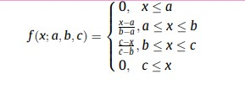
The triangular and the gaussian membership functions can be expressed in these two frame:
For the membership functions on the border the maximum value for example f(x) is extended to the corresponding border, look at the function down below:

Slide 33
Land use: meaning whether it is an Urban or Rural area and the linguistic variables are = Rural, Mixed and Urban.
Safety risk: Fatality Rate or the Safety measure and the linguistic variables are = low, medium and high
Highway Geometry: meaning is whether the route has a horizontal alignment or vertical and the curve radius, grades and the number of curves are taken into considerations. For this the linguistic variables are Poor, Reasonable and Good.
Terrain: meaning whether it is level, Rolling or mountainous and the linguistic variables are level, Rolling or mountainous
Intensity of Occupation: meaning the characteristics of Roadside condition such as whether it is residential, industrial, commercial, agricultural and the intensity of it. The linguistic variables for the intensity of occupation are low, medium and high.

Slide 34
Quantity of Roadside elements: meaning the distance from construction, bus stops and isolated elements such as trees, light poles etc and whether it is not protected by guardrails. The linguistic variables for the Quantity of Roadside elements are Few, reasonable and Many.

Slide 35

The number of parking spaces as proxy variable to the intensity of Occupation:
The continuation of membership function:
Here the a, b and c are parameters of the triangular membership
In the second formula MU is the mean and the small delta is the standard deviation.

Slide 36
The membership functions were created for each of the six input variables and for the output variable.
The same considerations for the input variables were used for the output variable.
Based on these 42 membership functions meaning the 7 variables * 3 linguistic * 2 types of membership functions were considered in this paper.

Slide 37
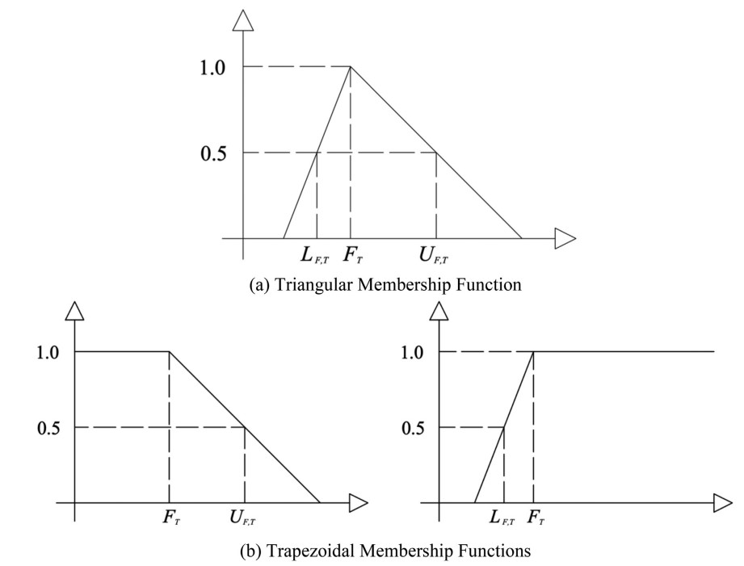
If the triangular membership function should be converted to a trapezoidal membership function the values of U(f,t) should be equal to 1 and this is similar to F(t) for the linguistic variables on the borders.
Picture 3 illustrate the example of trapezoidal membership functions and this function depicted in the picture illustrate the corresponding Gaussian membership functions using a similar fashion.

Slide 38

For the gaussian membership function only F(t) is used such as down below:
Here the experts’ answers were used to construct the examples for each premise.
In this case the fuzzy sets correspond to the examples
And the linguistics variables for each input variable corresponds to the premises.
Here the examples are the proxy variables used for quantification.

Slide 39
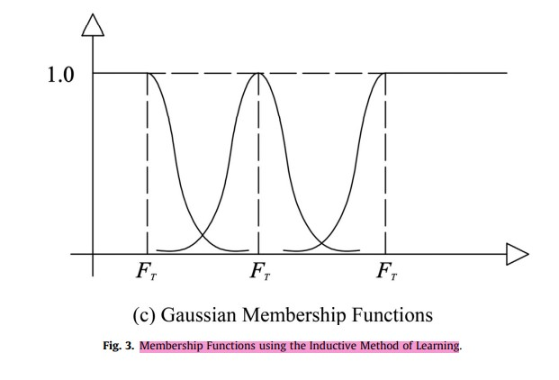
As a linguistic variable such as mountainous
The proxy variable such as average slope for this scenario was not considered as an example of the premise of this linguistic variable.
Gaussian membership functions were also constructed.
Gaussian functions can provide an additional degree of uncertainty and nonlinearity to the fuzzy systems.

Slide 40
The fuzzy rule section of the paper
The experts’ answer were also used to create the fuzzy rules.
Each respondent classified the input variables for each scenario and assumed a linguistic variable for the resulting speed limit.
This represents an if-the rule.
Therefore with 20 scenarios and 11 experts the maximum number of rules would be 220
But these rules were reduced for several reasons
First a lot of rules overlapped such as some answers were repeated
Second an excessive number of rules might lead to overfitting the fuzzy controller to the dataset

Slide 41
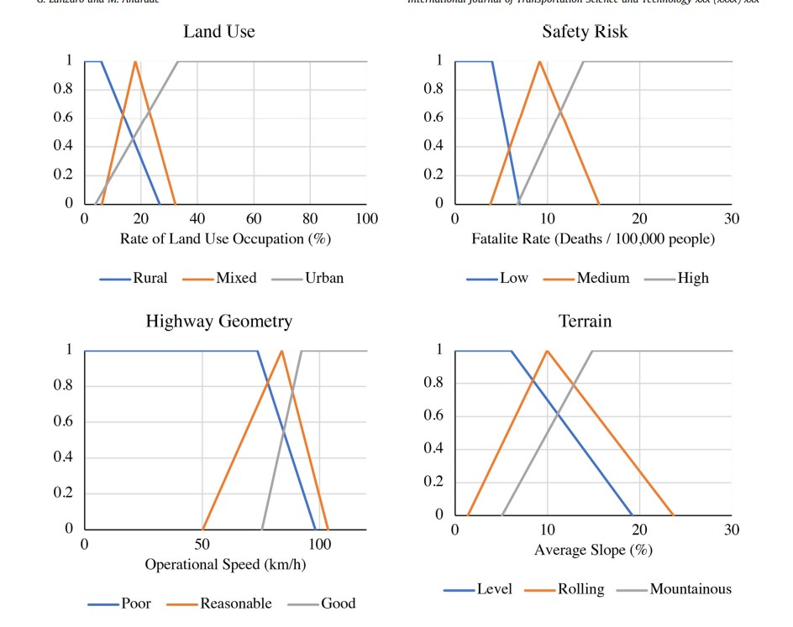
The experts opinion were extracted from the questionnaire and were used to develop the membership functions.
Here in the picture, we can see that the set of fuzzy membership functions for the input variables considering the triangular/trapezoidal and the gaussian shapes.

Slide 42
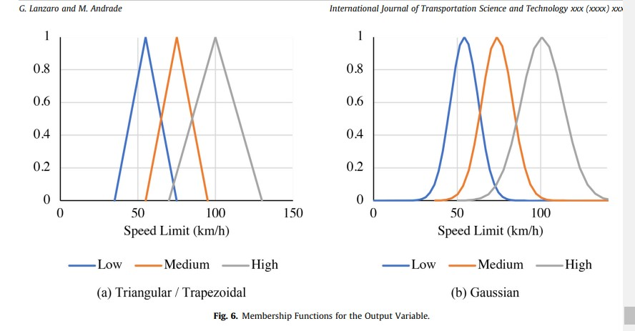
The figure down below shows that the membership functions for the input variables such as speed limit:

Slide 43
The defuzzification of the paper
Here we adopted the centroid method for defuzzification
We refer to this method as the center of the gravity (CoG)
Defuzzification is the process used to obtain the crisp outputs such as speed limits values.
This method considers the value of the output variables weighted by their membership functions.
This method tends to give a better representation of the several input variables

Slide 44

And the different categories instead of other methods that estimate the fuzzy outputs using extreme values such as maximum and minimum.
Here n is the number of linguistic variables for the output variables.
F(y) are the membership function values
And the y with line above are the centroids for each linguistic variable.

Slide 45
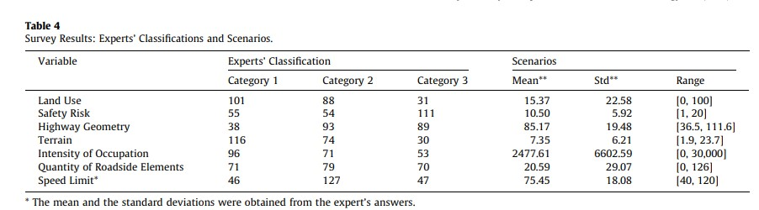
The survey result of this paper:
The table presents the classification for each category as well as the means.
For example, the land use variable had more classification for the “rural” linguistic variable.

Slide 46
Considering safety alone underestimating speed limits is better than overestimating speed limits because it leads to lower crash risk.
With this into consideration it should be noted that the fuzzy controller proposed in this paper represents a system to assist decision-making
The final decision for setting an appropriate speed limit should be from the expert.
The final output of the fuzzy controller can be adjusted by the decision-maker.

Slide 47
SUMMARY
The conclusion part of the paper:
This paper developed a fuzzy expert system for setting Brazilian highway speed limit.
A number of highway scenarios were constructed and experts were asked to both characterized the scenario in terms of linguistic values and to set speed limits.
Membership functions and fuzzy rules were extracted from the survey response.
Both triangular/trapezoidal and gaussian membership functions were considered.
The outputs of the fuzzy controller were compared to the mean of the experts’ answers.
In general, the system provided acceptable performance

Slide 48
THANK YOU
Najmieh Sadat Safarabadi
Fall 2022

